Slide 1
Scrap Review Data and Analysis
Otniel Abiezer

Slide 2
Scrapping the Data dan Preprocessing
From https://www.airlinequality.com/airline-reviews/british-airways with 1000 recent reviews (as for 12 March 2025) with BeautifulSoup Python.
Preprocessing the data such as drop '✅Trip Verified' and then lowercase, tokenizing, stemming, and stopword removal

Slide 3
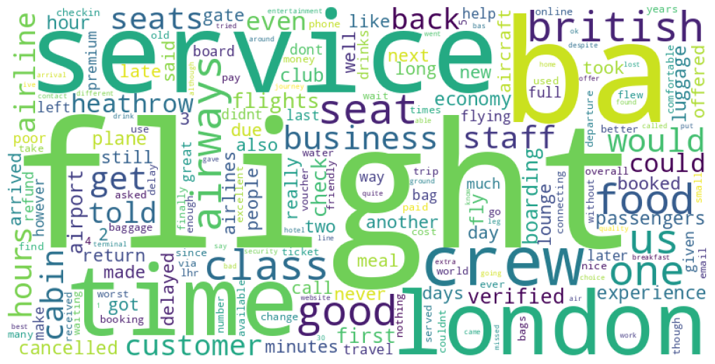
Word Cloud

Slide 4
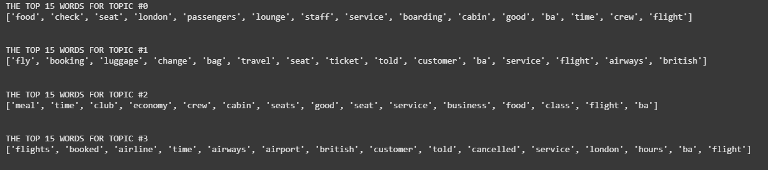
Topic Modeling
Using Vectorizer and Latent Dirichlet Allocation with 4 components:
Service
Flight term
Category or class
Time, Place, People

Slide 5
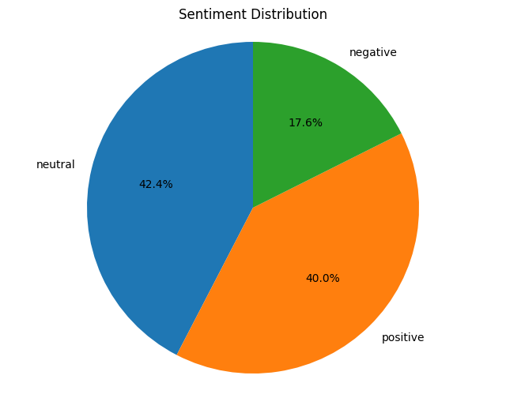
Sentiment Analysis
Using TextBlob Analysis Sentiment Polarity

